Slide 1

Authentic Assessment
Topic 4

Slide 2

Church Owned Bible Translation
Accuracy & Naturalness
MAST
Church Team

Slide 3
Scripture Translation Completed
Outside Translation
Consultant
?
MAST
APPROVED
Church Team

Slide 4
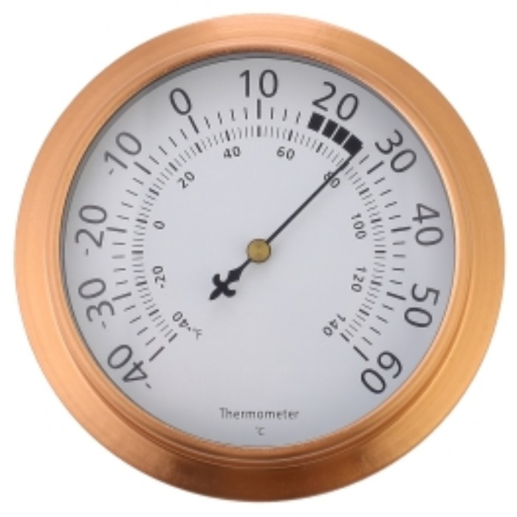
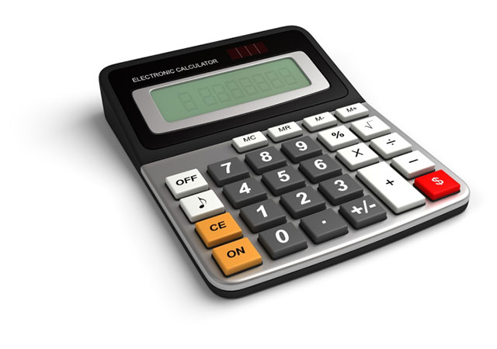
Types of Assessment
Subjective
Objective
Hot or Cold?
2 + 2 = 4?

Slide 5
Church Owned Assessment
Authentic Assessment Rubric
Church Team

Slide 6
Steps to Develop a Rubric
1
2
3
List 10 qualities of a good Scripture translation.
Define those qualities.
Develop a question (or questions) to measure if those qualities are present.

Slide 7
Examples of Translation Qualities
Accuracy
Clarity
Is the historical and geographical information faithful to the original?
Does the tone match that of the original?
Do the key terms accurately represent the meanings of the original?
Is the language simple and direct?
Are common terms used?
Is the message presented the way this culture would present it?

Slide 8
Using the Rubric
Self edit
Peer check
Keyword check
Verse-by-verse check
Community
Pastors
Teachers
Christian Leaders
MAST

Slide 9


